Slide 1
KLayout-PCell-Waveguide
Initiated by
Subhash C. Arya
Lightwave Communication System (LWCS) Laboratory, Department of ECE, NEHU Shillong, Meghalaya, India

Slide 2
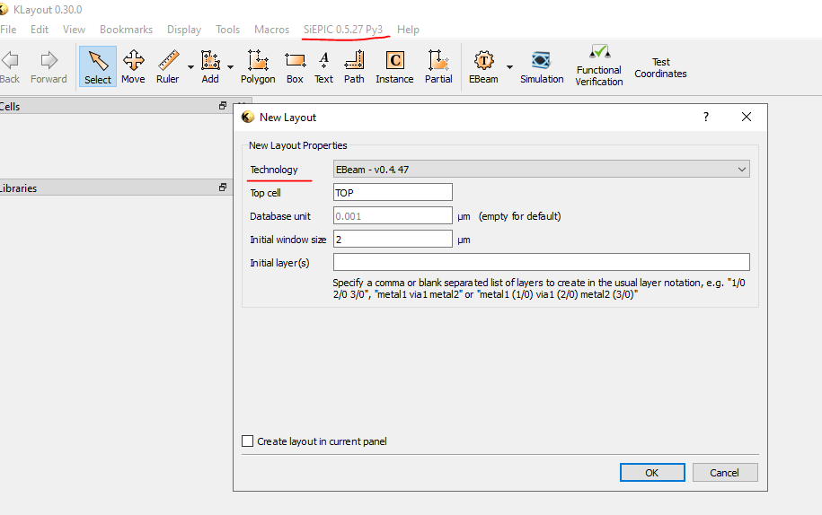
Setup on KLayout
Open Klayout (eg. Version 0.30.0) in which SiEPIC Tool (e g. Version 0.5.27
are SiEPIC Ebeam PDK (e.g. 0.4.47) installed with latest versions

Slide 3
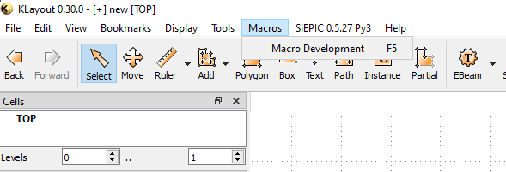
2. Open Macro Development

Slide 4
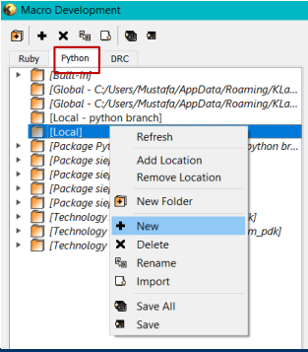
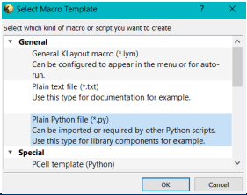
3. Create a new Python script in your local directory as shown in below image
Copy the Content of waveguide_pcell.py

Slide 5
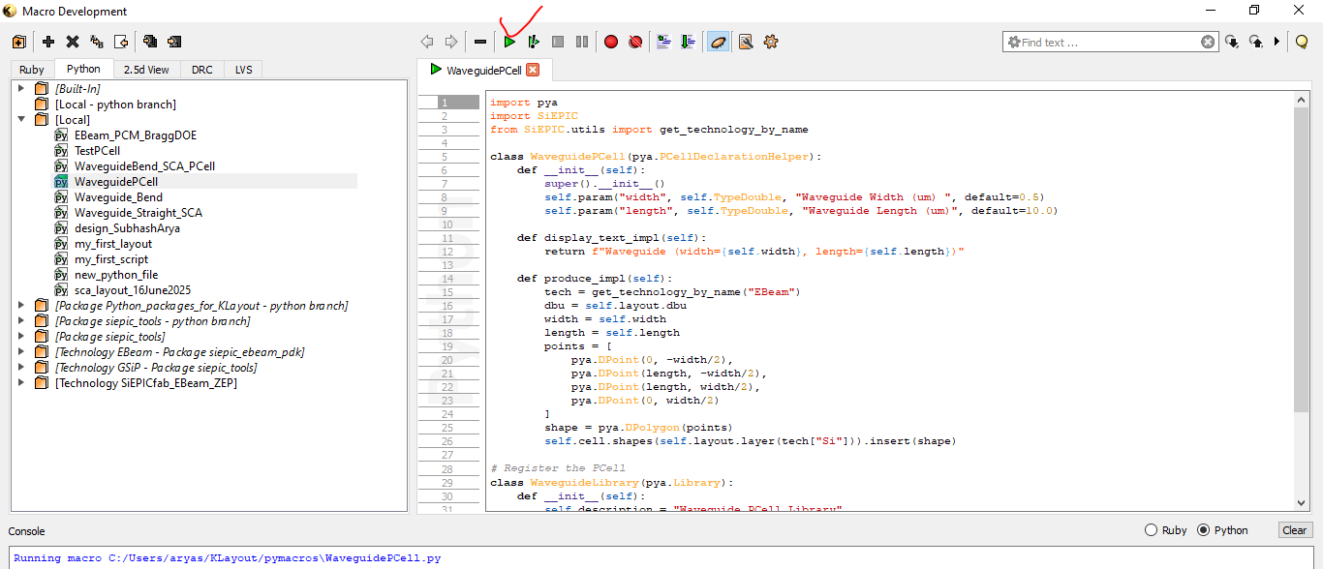
Run the Current Script of waveguide_pcell.py

Slide 6
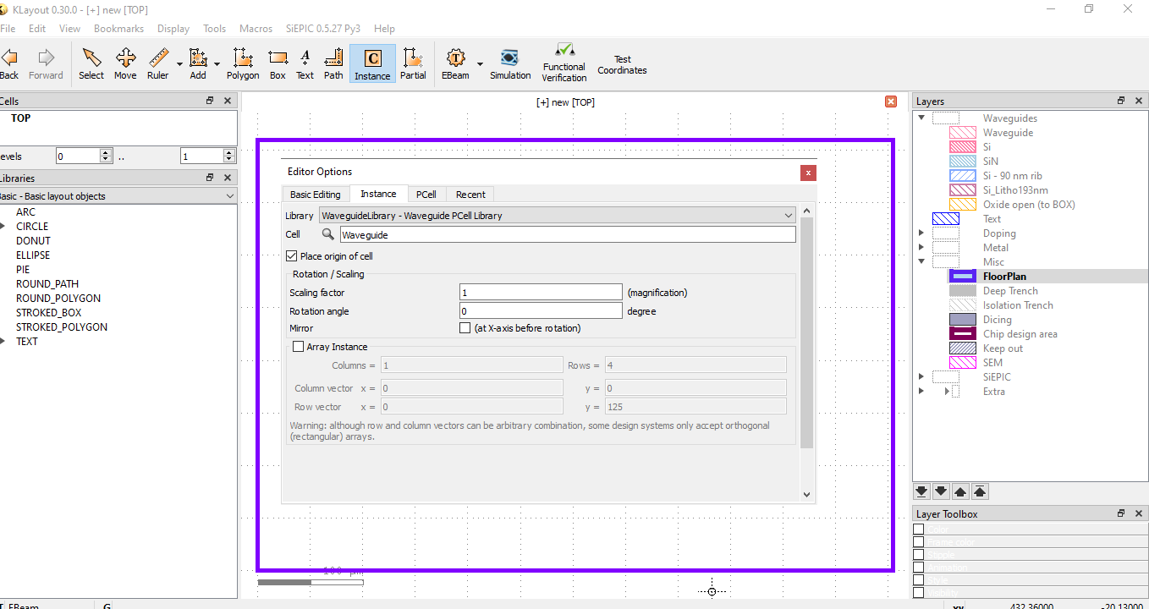
Create instance and select and select newly created WaveguideLibrary-Waveguide Pcell Library and Waveguide under Cell

Slide 7
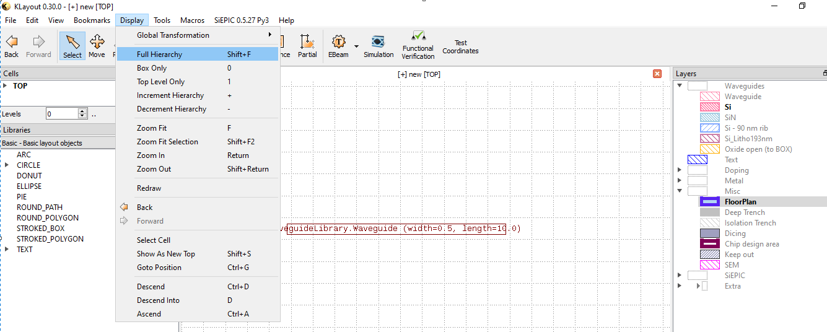
After placing waveguide instance, click on Display->Full Hierarchy (Shift+F)

Slide 8
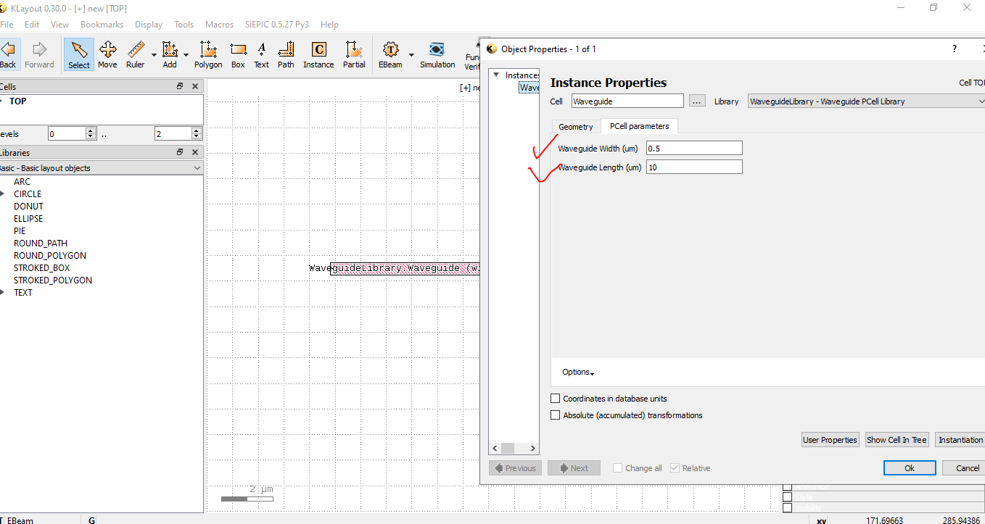
To navigate PCell parameter, select waveguide, hit q

Slide 9
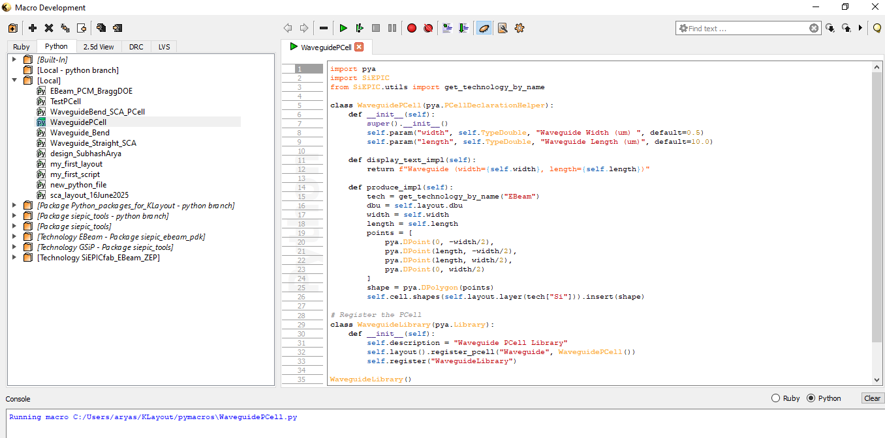
Macro development is the page where you can do improvement in the code

